Slide 1
Viewing

Slide 2
Finishing up from last time...

Slide 3
Non-Axis Aligned 3D Rotation
In 3D, you can rotate about an arbitrary axis! How to achieve this?
Euler Angles
Axis Angle
Quaternions
https://create3dcharacters.com/maya-animation-graph-editor-fundamentals/

Slide 4
Pros & Cons of Different Rotation Methods
 | Pros | Cons
Euler Angles | • Simple and intuitive | Allows tumbling: angles can go past 360 degrees (leading to lots of redundant ways to represent the same orientation) Gimbal lock
Axis Angle | No gimbal lock (so better for interpolation) Still reasonably intuitive. | Still allows tumbling Has singularities where different axis-angles represent the same rotation (e.g. 180 degrees about axis v vs. -180 degrees about axis -v)
Quaternion | No tumbling No gimbal lock No weird singularities (best for interpolation) | Very unintuitive way to represent rotations Have to re-normalize quaternions during interpolation (b/c only unit quaternions represent rotations)

Slide 5
Transformation Hierarchies

Slide 6
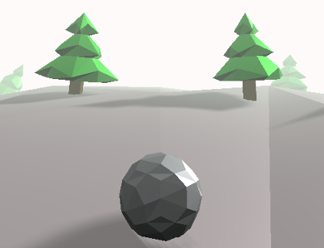
Scene Graph
Graphics applications typically represent scenes with a directed acylic graph (DAG):
Objects (cubes, sphere, cone, polyhedral, etc.):
stored as nodes (default: unit size at origin)
Attributes (color, textures, etc.):
stored as separate nodes
Transformations:
also nodes

Slide 7
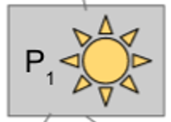
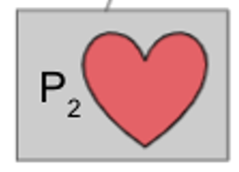

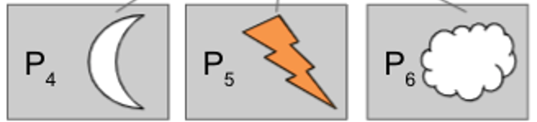
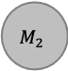
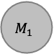

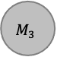
Scene Graph
For your assignments, we use simplified format:
Attributes stored as a components of each object node (no separate attribute node)
A transform node affects its subtree
Only leaf nodes are graphical objects.
All internal nodes that are not transform nodes are object group nodes
$$M_{world}$$
Group
$$M_{2}$$
$$M_{1}$$
Group
$$M_{3}$$
Group

Slide 8
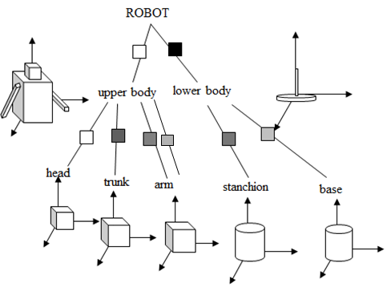
Scene Graph
Step 1: Various transformations are applied to each of the leaves (object primitives—head, base, etc.)
Step 2: Transformations are then applied to groups of objects (form upper and lower body, etc…)
Represents a
transformation

Slide 9
Scene Graph
This format means that instead of designing new primitives for every single shape we need, we can just apply transformations to a smaller set of primitives to form complex composite 3D shapes
Together the hierarchy of transformations forms the “robot” scene as a whole
Scene Graph
ROBOT
upper body
lower body
stanchion
base
head
trunk
arm

Slide 10
Scene Graph
A cumulative transformation matrix (CTM) builds as you move up the tree
Note that higher level transformation matrices are appended to the front of the sequence

Slide 11
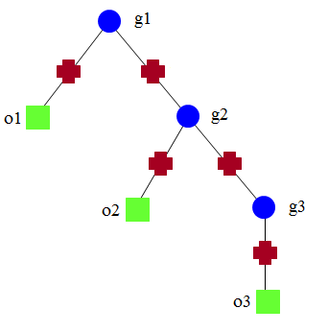
Scene Graph
For Example
For o1, CTM = M₁
For o2, CTM = M₂M₃
For o3, CTM = M₂M₄M₅
For a vertex v in o3, position in world coordinate system is CTM v = (M₂M₄M₅) v
M₁
M₂
M₃
M₄
M₅
object nodes (geometry)
transformation nodes
group nodes

Slide 12
Scene Graph
Reuse groups of objects (sub-trees in the scene graph)
i.e. robot’s 2 arms
Transformations defined within group 3 itself do not change; there are different CTMs for each use of group 3 as a whole
T₀T₁ vs. T₀T₂T₄
root
group3
group1
obj3
obj4
obj1
group3
group2
obj2
group3

Slide 13
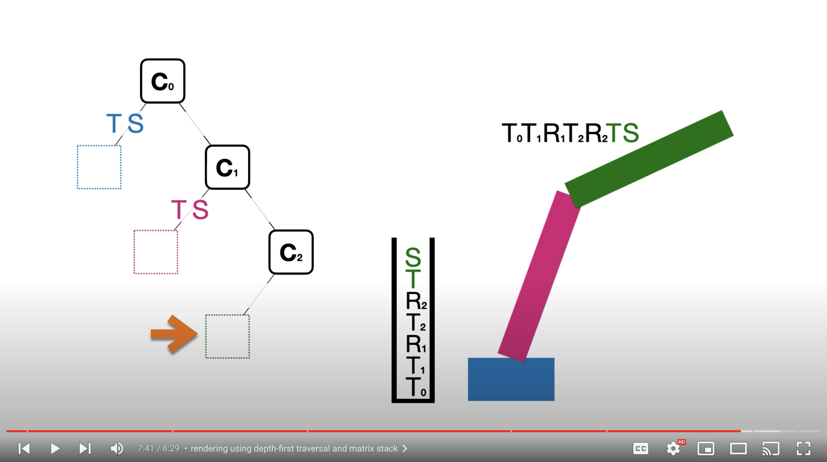
“Graphics in 5 Minutes” on Scene Graphs
YouTube link

Slide 14
Big Question for Today:
How to make a seemingly 3D picture on a 2D image plane?

Slide 15
How artists do it…

Slide 16
Perspective Drawing
“Realism” in art increased drastically with the introduction of perspective
Ratio and sizes
Foreshortening
https://www.invaluable.com/blog/understanding-linear-perspective-in-art/

Slide 17
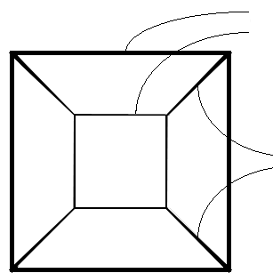
Rules of Linear Perspective
In a 2D drawing, parallel lines in 3D space either
Remain parallel in the drawing or
Converge to a vanishing point
Objects farther away are more foreshortened
edges same size,
with farther ones smaller
parallel edges converging

Slide 18
Types of Perspectives
Number of vanishing points
In computer graphics, we don’t explicitly program these. They’ll arise as consequences of our scene & camera choices!
https://people.eecs.berkeley.edu/~sequin/CS184/IMGS/Persp123PtProj.jpg

Slide 19
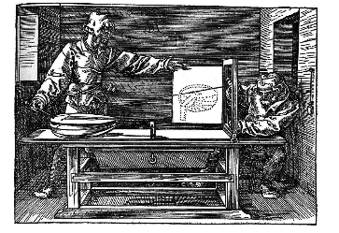
Perspective Machines
A tool that artists used to create a 'correct' perspective drawing
Run a string from a point on the object we want to draw to a point (on a wall) which is where the “viewer” would be.
Make a mark on paper where this string crosses the wooden frame.
Frame acts as a ‘window’ onto the scene
Albrecht Dürer, Man drawing a lute (1525)

Slide 20
Perspective Machines
An early, analog version of what computer graphics renderers do today!
Albrecht Dürer, Man drawing a lute (1525)

Slide 21
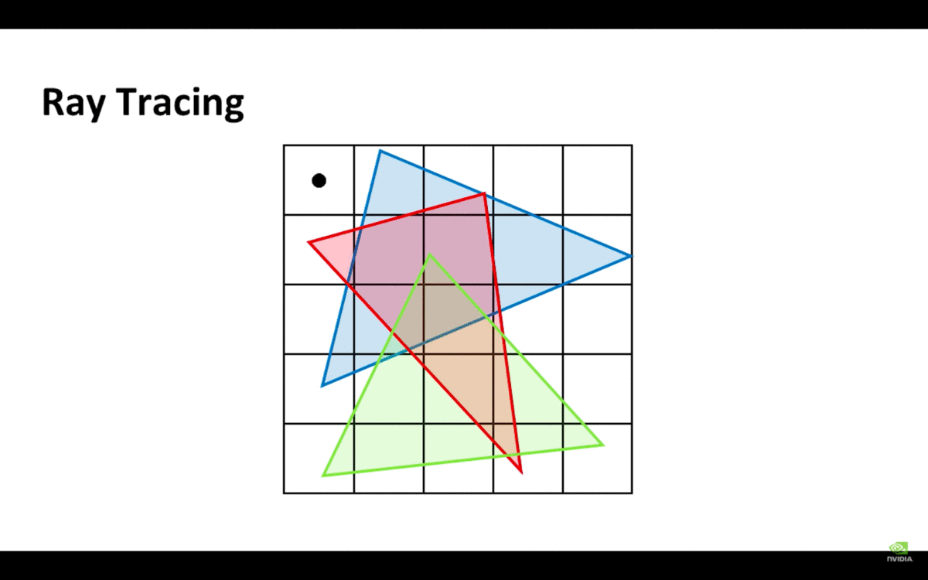
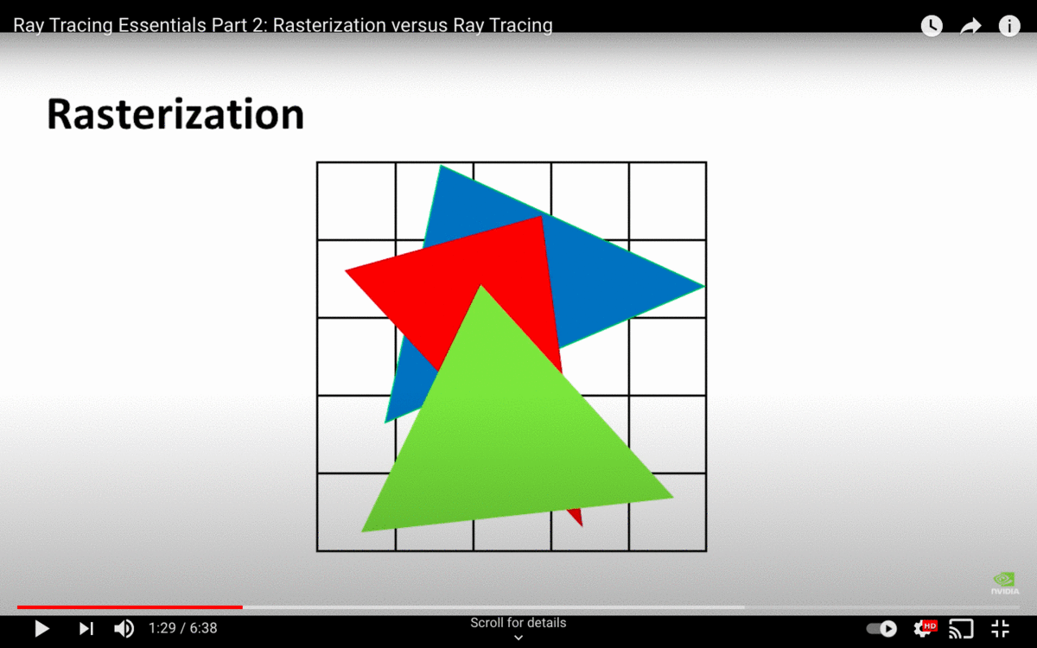
Rendering as perspective machine
Two possible approaches to making a picture
For every point on the paper, what object does the string cross?
For every object in the scene, what points on the paper does it cover?
These two approaches correspond to two major classes of rendering algorithm
Raytracing
Rasterization
More on this soon…
Albrecht Dürer, Man drawing a lute (1525)
https://www.youtube.com/watch?v=ynCxnR1i0QY

Slide 22
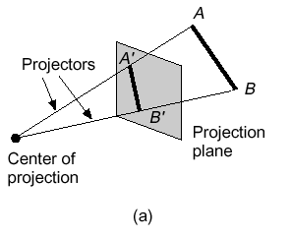
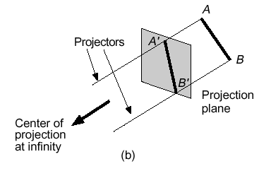
Perspective vs Parallel Projections
Perspective
Parallel
Determined by center of projection (in our diagrams, the “eye”)
Simulates what our eyes or a camera sees
Projectors are not parallel
Determined by direction of projection
Used in engineering and architecture
Projectors are parallel – do not converge to “eye”

Slide 23
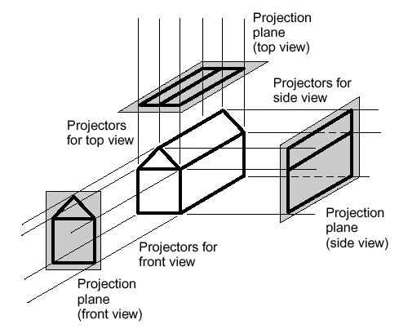
Parallel - Multiview Orthographic
Used for:
Engineering drawings of machines, machine parts
Working architectural drawings
Pros:
Accurate measurement possible
All views are at same scale
Cons:
Does not provide “realistic” view or sense of 3D form
Usually need multiple views to get a three-dimensional feeling for object
In all examples here, “projectors” perpendicular to ”image plane”

Slide 24
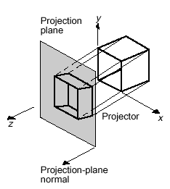
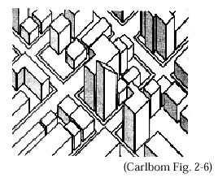
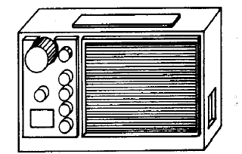
Parallel - Oblique Projection
Projectors at oblique angle to projection plane
Pros:
Can present exact shape of one face of an object (can take accurate measurements
Lack of perspective foreshortening makes comparison of sizes easier
Displays some of object’s 3D appearance
Cons:
Lack of perspective foreshortening (not realistic- looking)
Construction of
oblique parallel projection
Plan oblique projection of city
(from the top)
Front oblique projection of radio
(Carlbom Fig. 2-4)

Slide 25
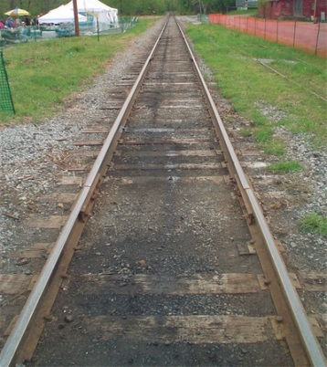
Perspective Projections
Used for:
Fine Art
Human visual system!
Pros:
Gives a realistic view and feeling for 3D form of object
Cons:
Does not preserve shapes of objects
Different from a parallel projection because
Parallel lines on object converge in the projection, unless parallel to the projection plane
Size of object is diminished with distance
If we were viewing this scene using parallel projection, the tracks would not converge

Slide 26
How cameras do it…

Slide 27
The Camera Obscura
A darkened box with a hole at one side through which an image is projected onto a screen
Caravaggio, Velázquez, da Vinci, and other hyperrealists may have used this to create their masterpieces
http://thedelightsofseeing.blogspot.com/2010/10/pinhole-photography-and-camera-obscura.html

Slide 28
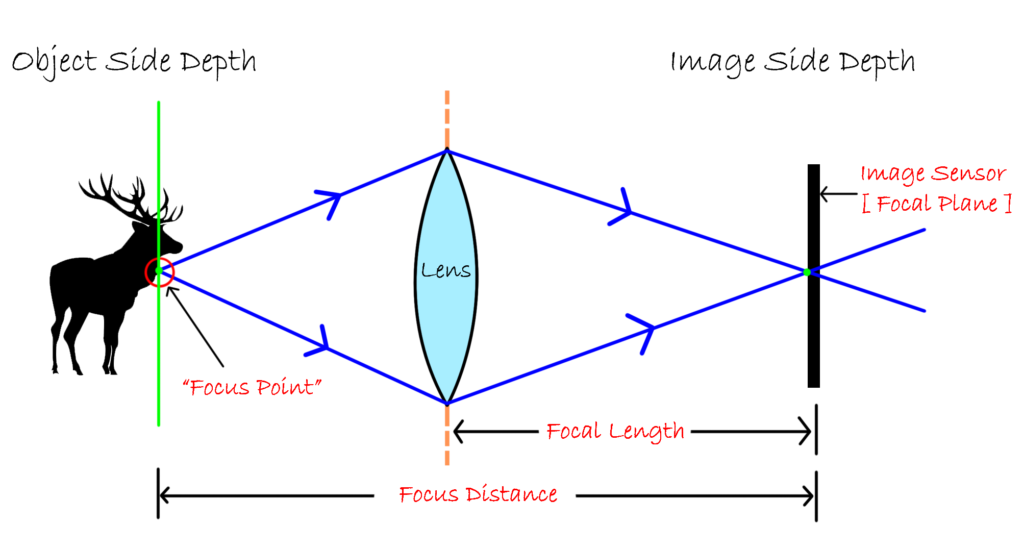
Anatomy of a “modern” camera
Film/sensor
Lens
Focal plane: plane in scene where rays from lens converge.
Distance between lens and sensor controls depth of the focal plane (called ‘focal length’).
https://arindamdhar.com/wp-content/uploads/2020/01/focus-diatance-and-focal-length_01.png

Slide 29
Anatomy of a “modern” camera
Bigger lens opening (aperture) increases among of defocus blur

Slide 30
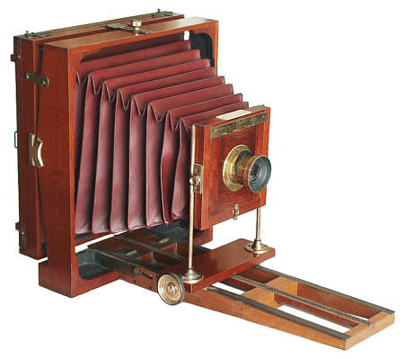
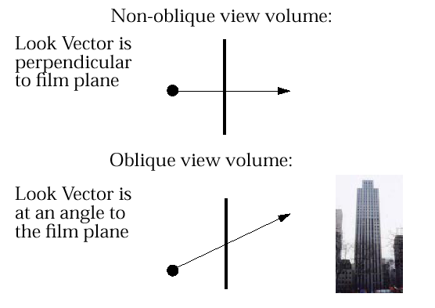
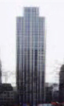
Oblique Perspective View Volume
View cameras have accordion housing to adjust the angle of the lens relative to the projection plane
to prevent vanishing point in Y, make film plane parallel to front façade while projectors tilt up
Oblique perspective

Slide 31
Defining a Virtual Camera

Slide 32
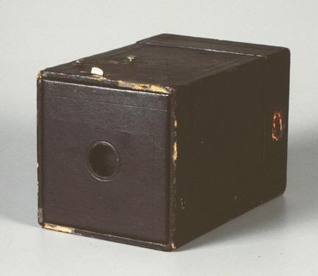
A Simplifying Assumption
Lens machinery makes things complicated.
For now, assume a ‘pinhole’ model (similar to the camera obscura, but idealized--lens is an infinitesimally small point).
Everything always in focus (though focal length still controls aspect ratio, as we will see).

Slide 33
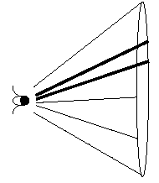
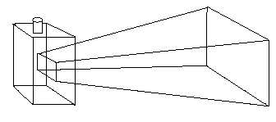
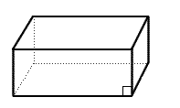
View Volumes
A view volume contains everything the camera sees
Conical – Approximates what eyes see, expensive math when clipping objects against cone’s surface
Frustum – Can approximate conical view volume with rectangular pyramid. Everything defined by linear equations – nice!
Parallel – Doesn’t simulate eye or camera (e.g., for orthographic projections). Does simulate very-long-focal-length views

Slide 34
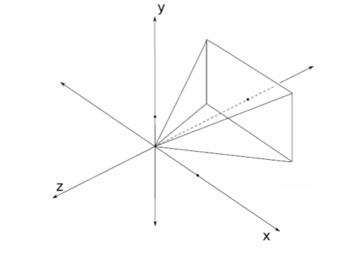
View Plane
AKA Projection Plane, Film Plane
View plane is in world space
3D scene is projected onto the view plane
View plane for our camera model will:
be perpendicular to the look vector
be centered around the look vector
match the dimensions of our view volume
be located somewhere between eye and scene
Look Vector
Look Vector
View
Plane
View Plane

Slide 35
View Volume Parameters
Parameters for perspective view frustum:
Position
Look Vector
Orientation
Aspect Ratio
View Angle
Look Vector
View
Plane

Slide 36
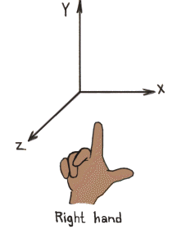
View Volume (1. Position)
Where is the camera located with respect to the origin, in the world coordinate system?
Courtesy of http://viz.aset.psu.edu/gho/sem_notes/3d_fundamentals/gifs/left_right_hand.gif

Slide 37
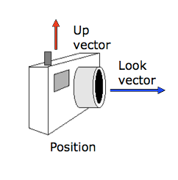
View Volume ( 2. Look Vector)
Look vector specifies the direction camera is pointing.
In some graphics frameworks, look vector is not specified directly but is derived using ‘eye’ and ‘center’ camera parameters, which are the camera’s position and the point it’s looking at, respectively

Slide 38
View Volume (3. Orientation)
Orientation is specified by a direction to look in and a non-collinear vector Up from which we derive the rotation of the camera about Look
Often points from position to top of camera
Up-vector is often (0,1,0)
y
x
-z
Up vector
point to look at (x’, y’, z’)
Camera position
Look vector
z

Slide 39
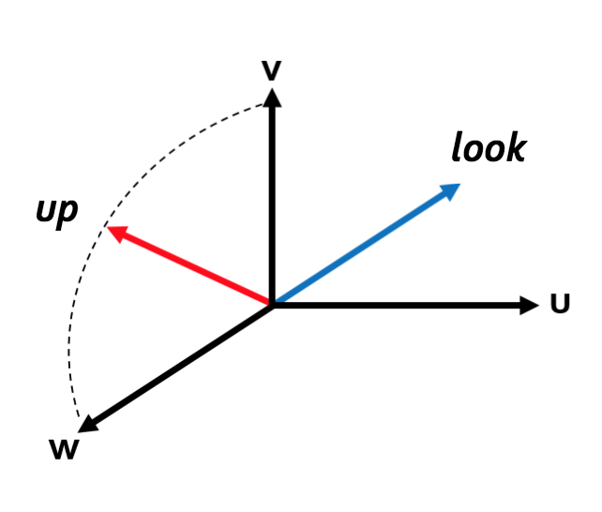
The Camera Coordinate System
The equivalent of x, y and z world coordinate axes in camera space are unit vectors u, v, w
Also a right handed coordinate system
w is a unit vector in the opposite direction of look (i.e. look lies along the –-w axis)
v is the component of the up vector perpendicular to look, normalized to unit length
u is the unit vector perpendicular to both v and w

Slide 40
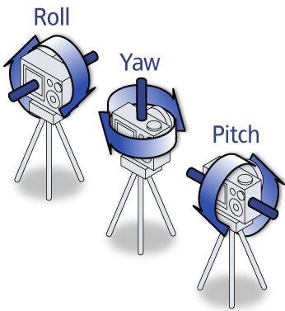
Operations in Camera Coordinate Space
Roll:
Rotating your camera around look
Yaw:
Rotating your camera around v
Pitch:
Rotating your camera around u
Roll, Yaw, Pitch image courtesy of http://3.bp.blogspot.com/_dbbuwCxZzCE/TQuhLBALxJI/AAAAAAAAAAo/oV8D5B4YijQ/s1600/pry.png

Slide 41

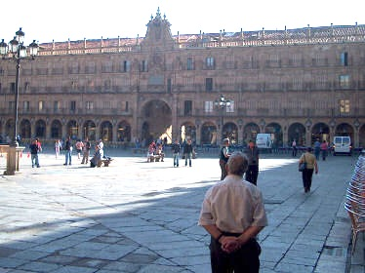
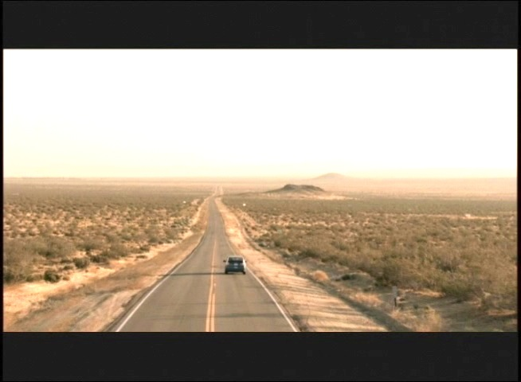
View Volume (4. Aspect Ratio)
Ratio of width to height of viewing window
usually defined by screen being used, or by common ratios (e.g. 16:9)
Aspect ratio can be determined by view angles
1:1
Courtesy of http://www3.flickr.com/photos/zerogrizzly/4037144257/
Courtesy of http://forum.videohelp.com/threads/236536-720-vs-704
4:3
Courtesy of http://en.wikipedia.org/wiki/File:Aspect_ratio_4_3_example.jpg
16:9

Slide 42
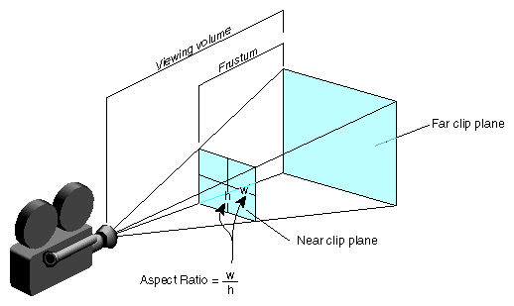
View Volume (5. View Angle)
Determines amount of perspective distortion in picture
In a frustum, there are two viewing angles: width and height angles
Choosing view angle is analogous to photographer choosing a specific type of lens (e.g., a wide-angle or telephoto lens)
Width angle
Height angle

Slide 43
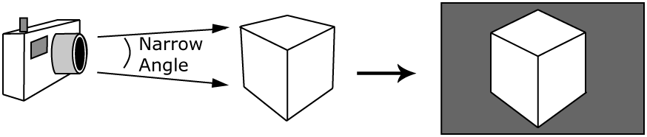
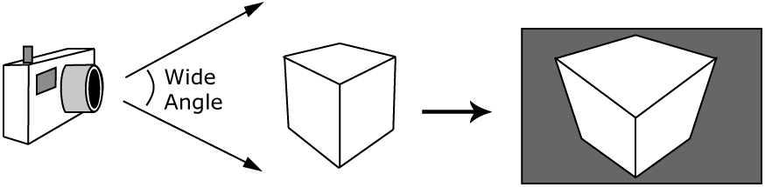
View Volume (5. View Angle)
Telephoto lenses made for distance shots often have a nearly parallel viewing angle and cause little perspective distortion, though they foreshorten depth (condense space)
Wide-angle lenses cause a lot of perspective distortion (expand space)

Slide 44

View Volume (5. View Angle)
Wide lens (high distortion):
29 mm;
1 foot away
Telephoto lens (no distortion):
105 mm;
12 feet away
https://petapixel.com/2013/01/11/how-focal-length-affects-your-subjects-apparent-weight-as-seen-with-a-cat/

Slide 45
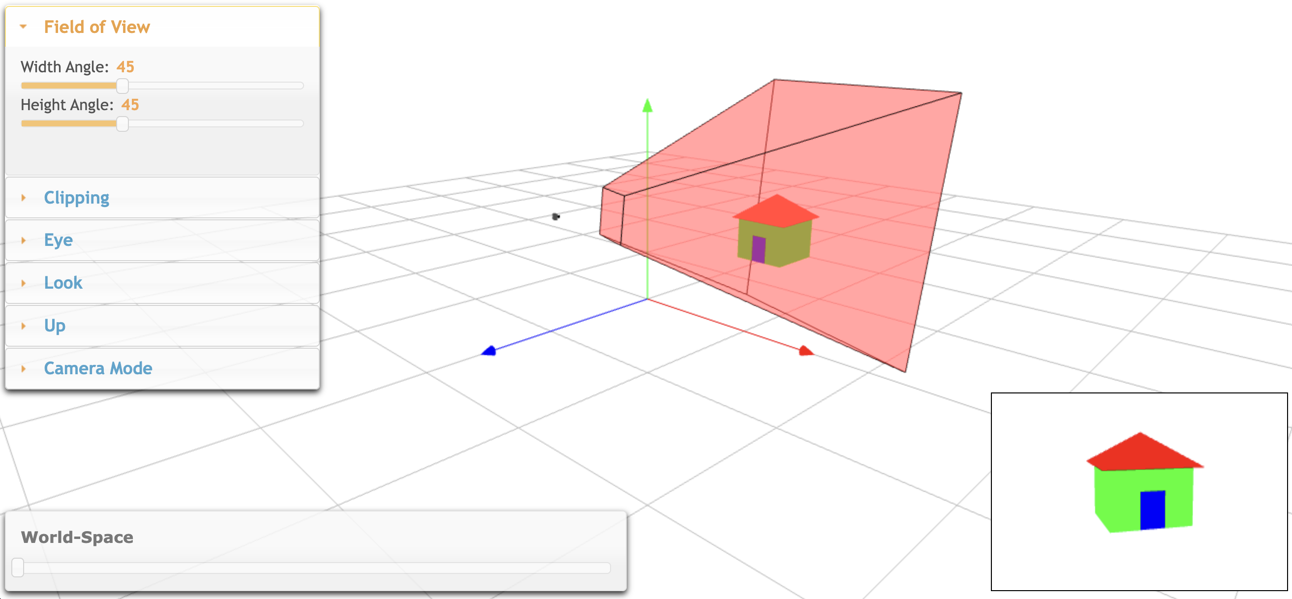
Viewing Demo
Link: https://cs1230.graphics/demos/camera/

Slide 46
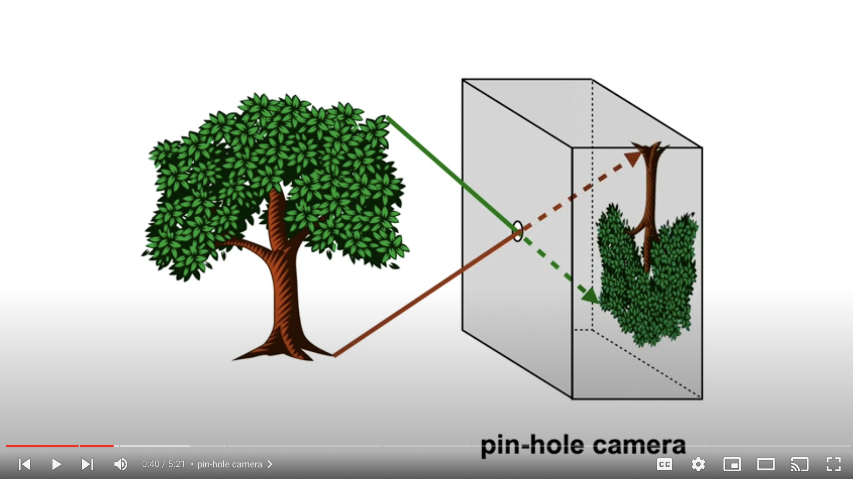
“Graphics in 5 minute” on perspective projection
YouTube link

Slide 47
Computing Camera Coordinate Systems

Slide 48
Finding u, v, and w
We want the u, v, w orthonormal camera coordinate system axes to have the following properties:
Our arbitrary look vector will lie along the negative w-axis
The v-axis will be defined by the vector perpendicular to look, and will lie in the plane defined by look and up
The u-axis will be mutually perpendicular to the v- and w-axes, and will form a right-handed coordinate system
First find w from look, then find v from up and w, then find u as a normal to the wv-plane

Slide 49
Finding w
Finding w is easy. look should lie on –w, so w is a normalized vector pointing in the direction opposite to look

Slide 50
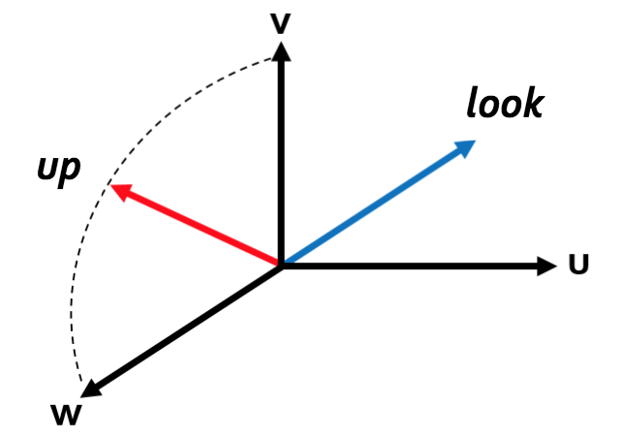
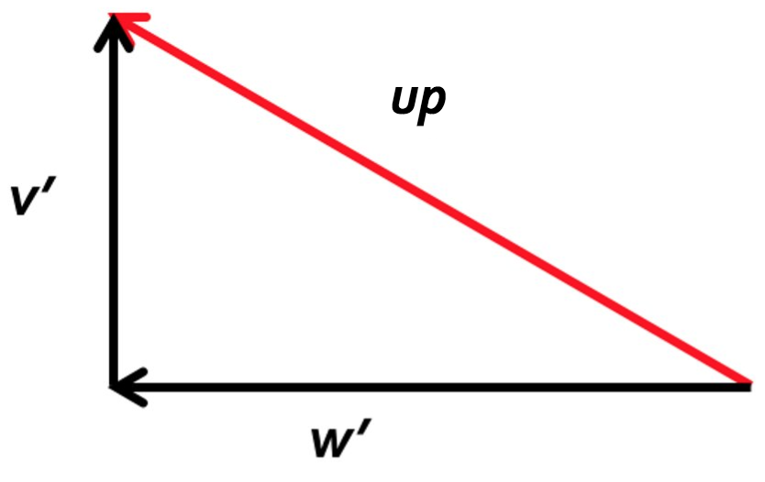
Finding v
Problem: we have to find a unit vector v that is perpendicular to the unit vector w in the look-up plane
Solution: subtract the w component of the up vector to get v’ and normalize. To get w component w’ of up, project up onto w:
Projection of up onto w, because w is a unit vector
w
Looking directly at wv-plane

Slide 51
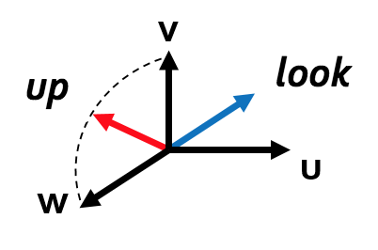
Finding u
We can use the cross-product, but which? Both w × v and v × w are perpendicular to the plane, but they go in opposite directions.
Answer: cross-products are “right-handed,” so use v × w to create a right-handed coordinate frame
As a reminder, the cross product of two vectors a and b is:

Slide 52
Finding u,v,w
To Summarize:

Slide 53
Finding u,v,w in GLM
// Given
glm::vec3 look; // look vector
glm::vec3 up; // up vector
// Compute
glm::vec3 u; // cam space vector to “right”
glm::vec3 v; // cam space vector from eye to top of camera
glm::vec3 w; // cam space vector opposite ”look” vector
w = -look; w.normalize();
v = up - dot(up, w)*w;
v.normalize();
u = cross(v, w);

Slide 54
Transforming into Camera Space

Slide 55

The value of a ‘canonical camera space’
Our ultimate goal is to project what the camera sees onto a 2D image.
We could implement a procedure that does this for all possible virtual camera locations/orientations...
...or we could do the following:
Transform into a canonical space where the camera is sitting at the origin, looking down –z, and oriented such that y is up.
Implement a renderer that only has to deal with this canonical camera setup.
Which do you think sounds easier? ;)
y
v
u
w
v
u
x
w
z

Slide 56
Camera Transformation
We need a 4x4 matrix to translate to the origin and rotate to align u, v, w, with x, y, z.
Putting the camera at the origin
Camera should be located at (0,0,0)
Orient upright
v vector = (0,1,0)
Look down negative z
look vector = (0,0,-1)

Slide 57
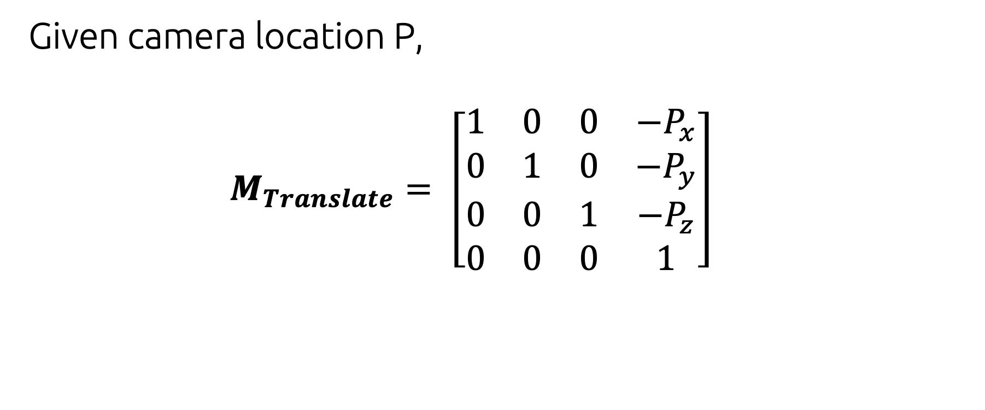
View Volume Translation
Given camera location P,
$$M_{Translate}= \left[\begin{matrix}1 & 0 & 0 & {−P}_{x} \\ 0 & 1 & 0 & {−P}_{y} \\ 0 & 0 & 1 & {−P}_{z} \\ 0 & 0 & 0 & 1\end{matrix}\right]$$

Slide 58
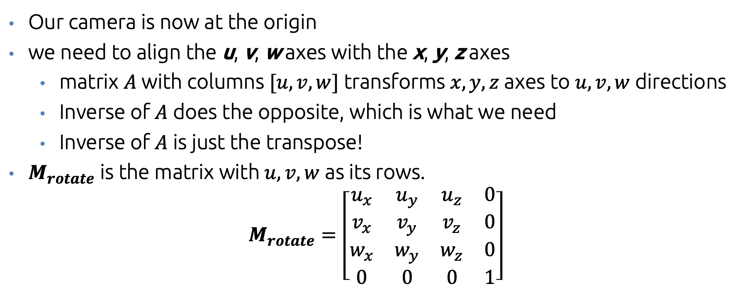
View Volume Rotation
Our camera is now at the origin
we need to align the u, v, w axes with the x, y, z axes
matrix $A$with columns $[u, v, w]$ transforms $x,y,z$ axes to $u,v,w$ directions
Inverse of $A$ does the opposite, which is what we need
Inverse of $A$ is just the transpose!
$M_{rotate}$ is the matrix with $u,v,w$ as its rows.
$$M_{rotate}=\left[\begin{matrix}u_{x} & u_{y} & u_{z} & 0 \\ v_{x} & v_{y} & v_{z} & 0 \\ w_{x} & w_{y} & w_{z} & 0 \\ 0 & 0 & 0 & 1\end{matrix}\right]$$

Slide 59
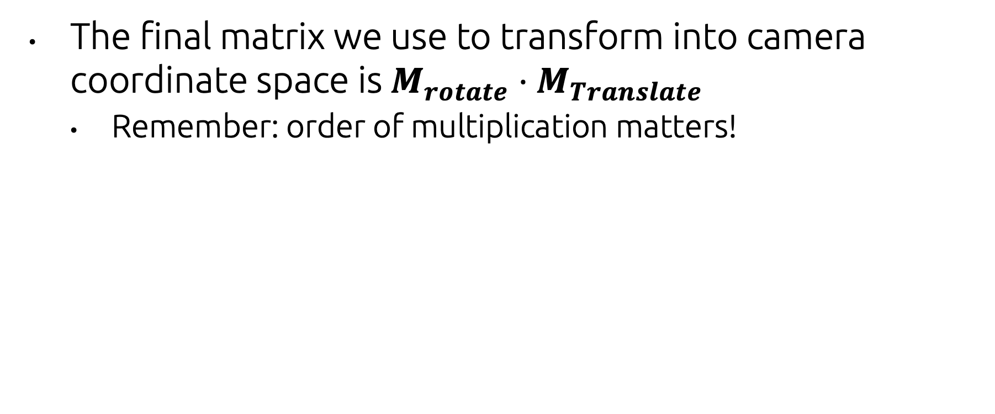
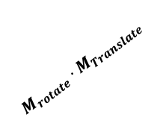
All together now
The final matrix we use to transform into camera coordinate space is $M_{rotate}⋅M_{Translate}$
Remember: order of multiplication matters!
y
v
u
$$M_{rotate}⋅M_{Translate}$$
w
v
u
x
w
z

Slide 60
All that’s left
How do we take the 3D objects we can ‘see’ at each point in camera space and turn them into pixels? That’s what we’ll talk about next!

Slide 61
Acknowledgments
These slides were created by:
Daniel Ritchie
Yuna Hiraide
Andy van Dam
...and many past CSCI 1230 TAs!

